Slide 1

Sprint 1 demo
A00249365

Slide 2
Contents of presentation
What goals were set for sprint 1
Sprint 2 plan
Demo of what I got working

Slide 3
Sprint 1 goals
Set up weight sensor with esp 8266 and check readings
Set up mqtt connection from esp 8266 to the broker
Merge weight senor program and with mqtt program on esp 8266
Set up data exchange from esp 8266 to phone via mqtt

Slide 4
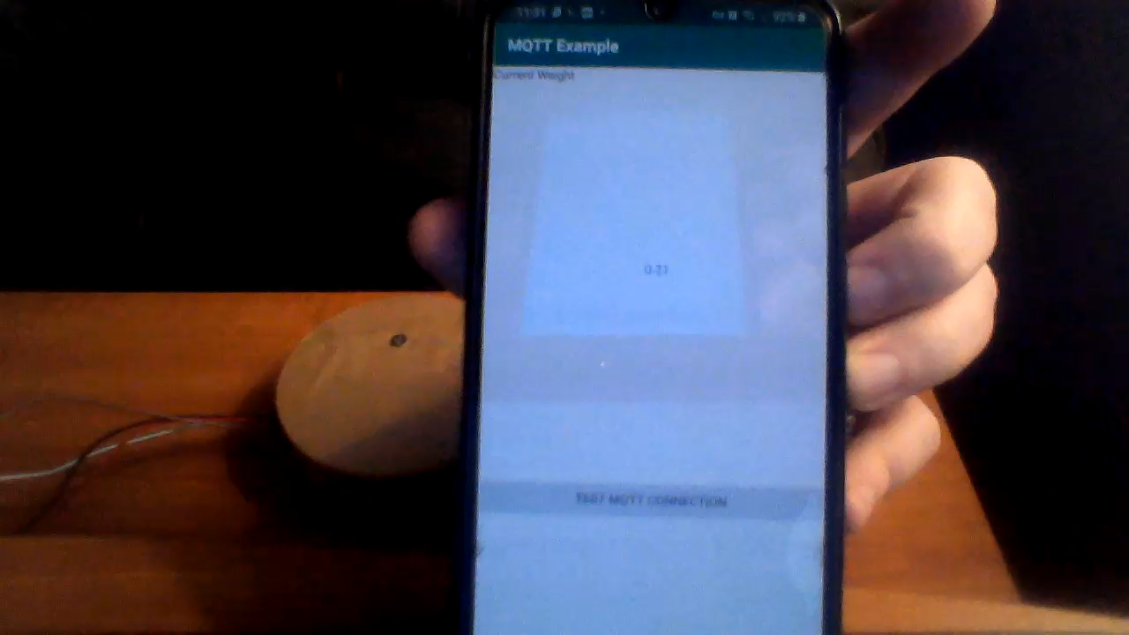
Demo of project working so far

Slide 5
Goals for sprint 2
Primary goals:
Handle the data that is being sent over to the phone
Implement UI features i.e adding items to the fridge and viewing what’s in the fridge.
Secondary goals:
Shopping list features
Bar code scanner implementation
Possible second sensor

Slide 6
Questions or feedback
Thanks for listening

